Slide 1

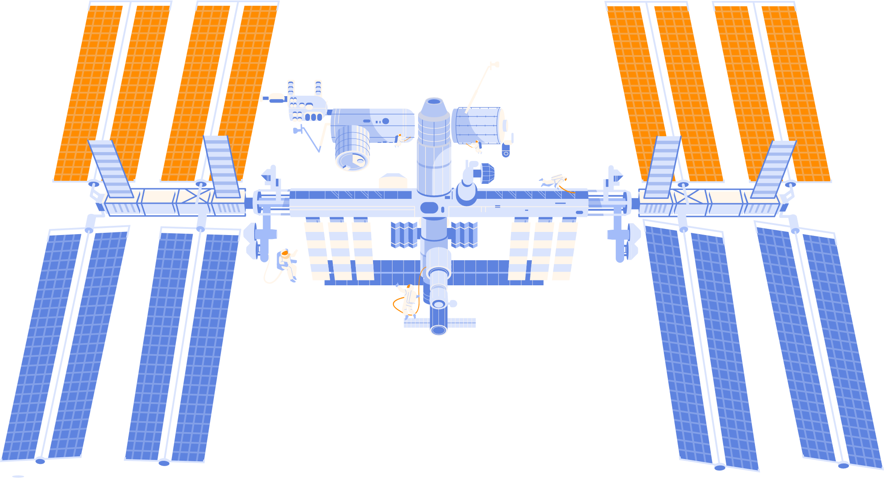
The
Space y launch data analysis

Slide 2


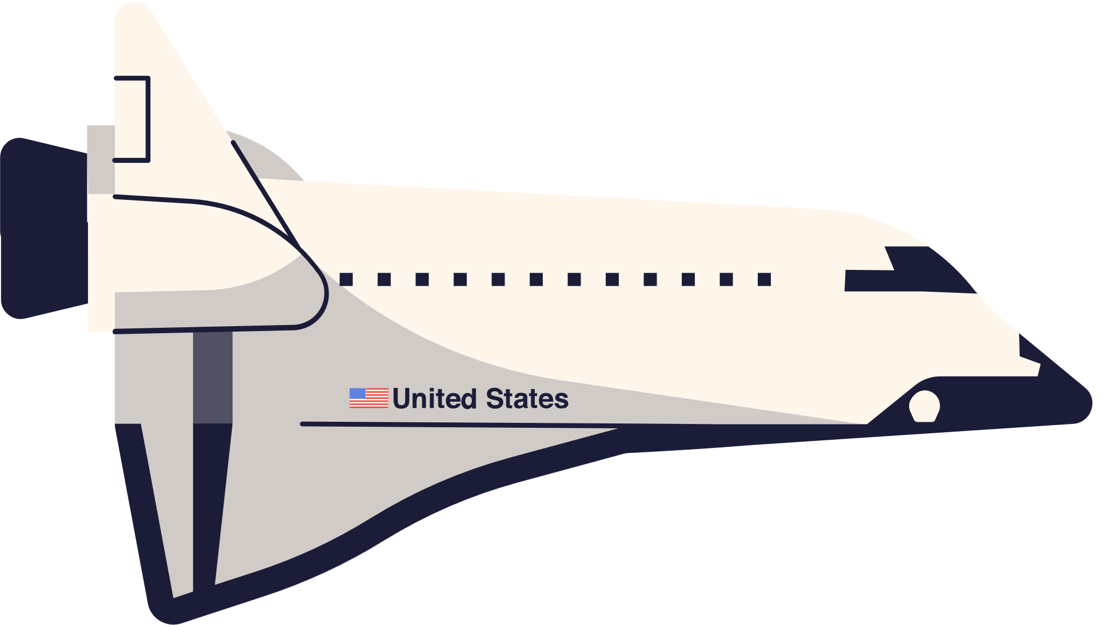

introduction
Overview: Space Y advertises Falcon 9 rocket launches on its website with a cost of 62 million dollars; other providers cost upward of 165 million dollars each, much of the savings is because Space Y can reuse the first stage. Therefore, we need to apply Data Science methodology to analyze publicly available data on Falcon 9 rocket launches to predict the likelihood of the first stage landing and estimate how probable the official Space Y statement is about 62 million dollars of a launch cost.

Slide 3
introduction
Objective: This project aims to predict the success of SpaceY launches based on historical data, helping optimize future missions.
Tools & Techniques: Python, Scikit-learn, GridSearchCV, MLflow, Gradio

Slide 4
Problem statement
Define the Problem: Predicting launch success is vital for:
Efficient resource allocation
Risk management
Mission success rates
Target Variable: Launch success (binary: 1 = Success, 0 = Failure).

Slide 5


Our team roles
Ahmed Nashat
Ahmed Nagy
Awwab Khalil
Sohila Araby
Aya Reda

Slide 6

Ahmed nashat
Data Collection
Data Exploration

Slide 7
Ahmed nagy
Data Cleaning
Data Analysis

Slide 8
Awwab khalil
Data Visualization Using Python
Data Visualization Using Power BI

Slide 9
Sohila arabi
Model Selection
Model Training

Slide 10
Aya reda
MLflow Integration
Deployment
Conclusion

Slide 11


Data Collection and Exploration
MLOps, Deployment, and Final Presentation
Data Analysis
Project Elements
Data visualization
Machine Learning Model Development

Slide 12
Data collection and exploration
Data Collection
Data Exploration

Slide 13
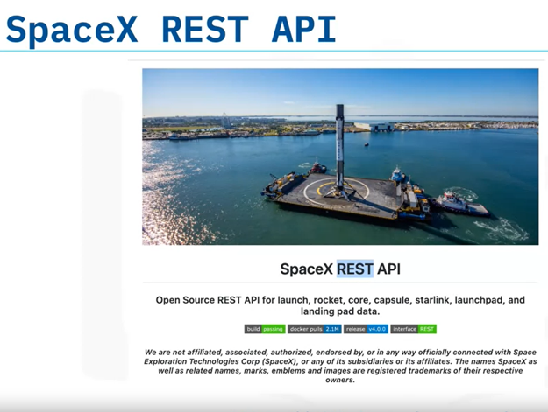
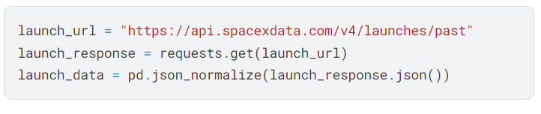
Data collection and exploration
Data Collection
Data Source: The dataset is sourced from the SpaceY API.
Data Exploration

Slide 14
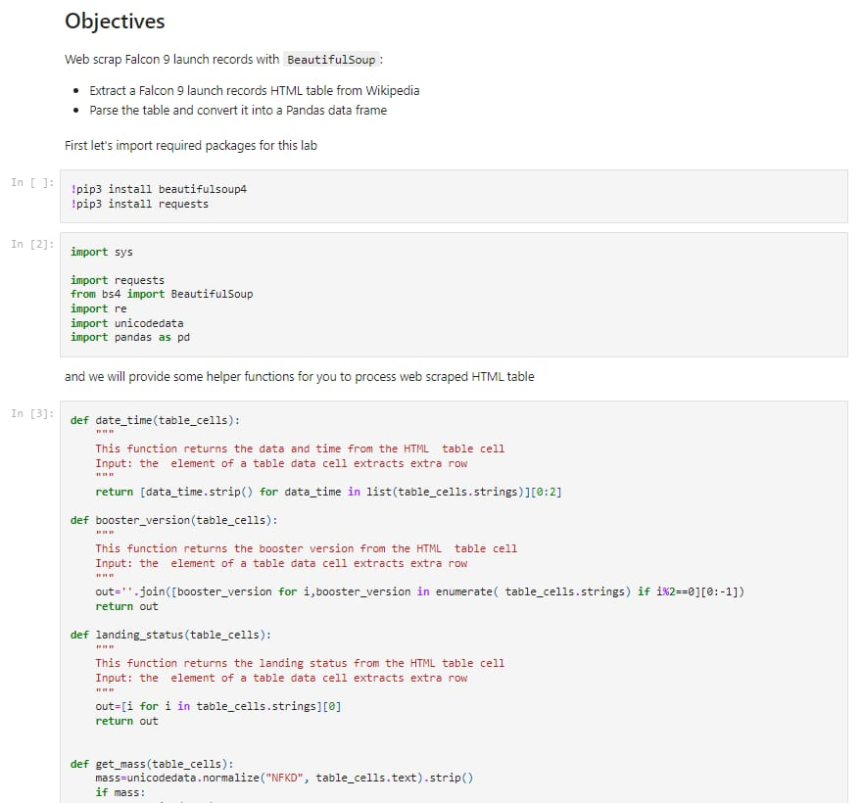
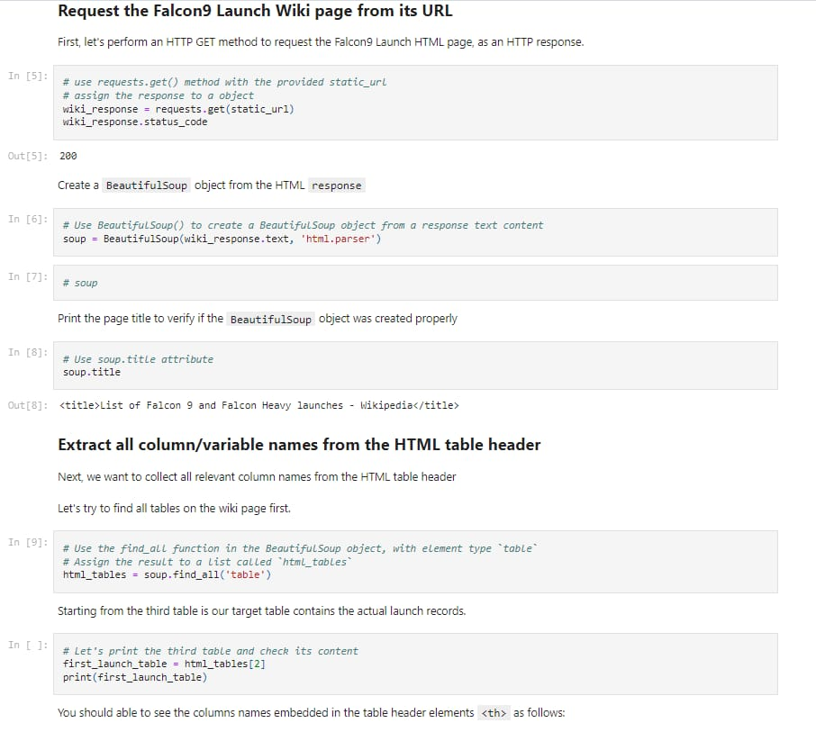
Data collection and exploration
Data Collection
Data Source: The dataset is sourced from wikipedia through web scraping technique
Data Exploration

Slide 15
Data collection and exploration
Data Collection
Data Exploration

Slide 16
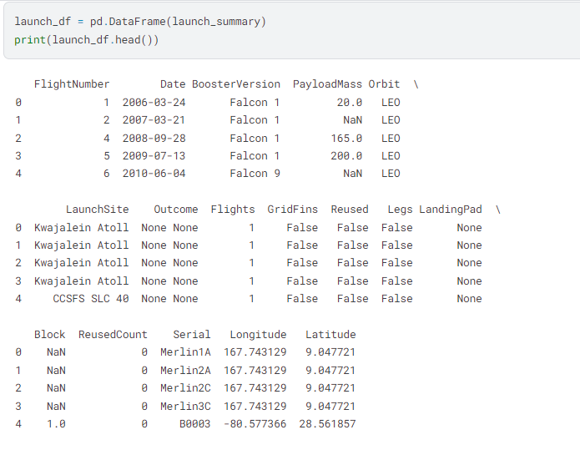
Data collection and exploration
Data Exploration
Key Features:
- Launch Date
- Booster Version (e.g. Falcon 9)
- Launch Site (e.g., CCSFS SLC 40, Kwajalein Atoll)
- Payload Mass (in kg)
- Mission Outcome (Success/Failure)
- It seems we have missing values in some columns (e.g. PayloadMass)
Data Collection

Slide 17
Data cleaning and analysis
Data Cleaning
Data Analysis

Slide 18
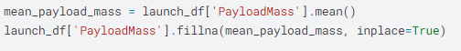
Data analysis
Data Cleaning
Cleaning Steps:
1- Handle missing payload data by replacing NaN with the mean payload mass
This code fills in any missing values in the PayloadMass column of the launch_df DataFrame with the average value of the non-missing payload masses.
Data Analysis
Data Visualization

Slide 19
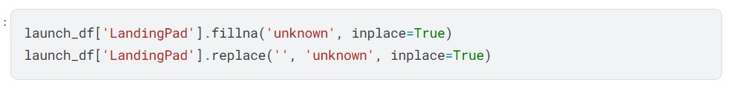
Data analysis
Data Cleaning
Cleaning Steps:
- Filling missing values (NaN) in the LandingPad column with 'unknown':
- Replacing empty strings ('') in the LandingPad column with 'unknown':
2- Save the cleaned data to a CSV file
Data Analysis
Data Visualization

Slide 20
Data analysis
Data Cleaning
Data Analysis

Slide 21
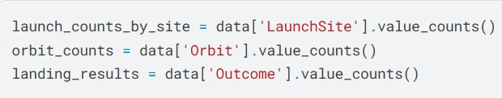
Data analysis
Data Analysis
Count the number of launches by site and orbit, and gather landing outcomes:
The first line counts the number of launches from each launch site.
The second line counts how often each type of orbit is used.
The third line counts the outcomes of the landings (e.g., success, failure) for each launch.
Data Visualization
Data Cleaning

Slide 22
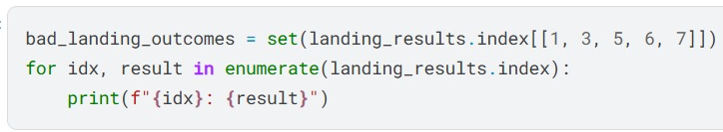
Data analysis
Data Analysis
Identify bad landing outcomes:
The first line creates a set of "bad landing outcomes" by extracting values at specific indices from landing_results.index.
The loop then prints each index and its corresponding value from landing_results.index.
Data Visualization
Data Cleaning

Slide 23
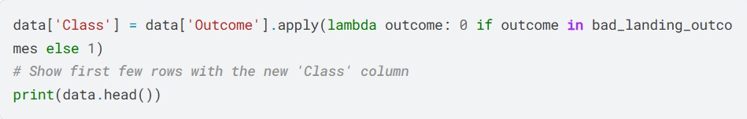
Data analysis
Data Analysis
Create a binary classification based on landing outcomes:
The code assigns a binary classification (0 for bad landings and 1 for good landings) to each row in the DataFrame, based on the Outcome column.
It then prints the first few rows of the modified DataFrame to show the new Class column.
Data Visualization
Data Cleaning

Slide 24
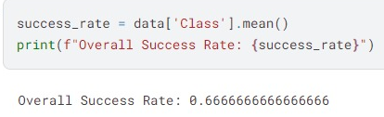
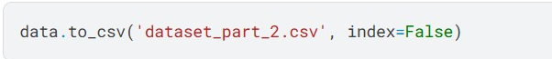
Data analysis
Data Analysis
Calculate overall success rate:
The code calculates the overall success rate of the landings by finding the mean of the Class column.
The result is printed, showing the proportion of successful outcomes among all landings.
Save the modified dataset to a new CSV file:
Data Visualization
Data Cleaning

Slide 25
Data visualization
Data Visualization Using Python
Data Visualization Using Power BI

Slide 26
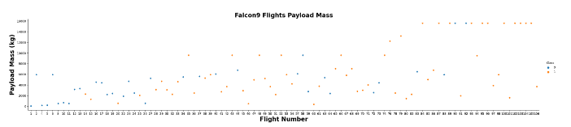
Data visualization
Data Visualization Using Python
In order to evaluate the relationship between the studied variables we built the following Scatterplots:
Payload Mass vs.Flight Number
The variation in payload mass for different Falcon 9 flights indicates the diverse nature of its missions. Some missions require heavier cargo, while others involve lighter payloads. This range of payloads demonstrates that the Falcon 9 rocket has consistently performed well, effectively supporting a wide array of weights throughout its operational history.
Data Analysis
Data Cleaning

Slide 27
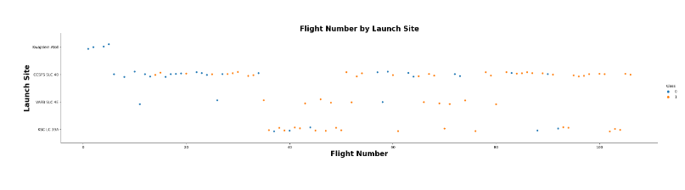
Data visualization
Data Visualization Using Python
Launch Site vs. Flight Number
Most Falcon 9 flights launch from CCSFS SLC 40, followed by KSC LC 39A and VAFB SLC 4E. The flight numbers range from about 1 to over 80, showcasing the growth of Falcon 9 missions over time. There is no evident trend in success rates, as both successful and unsuccessful flights are distributed across various flight numbers.
Data Analysis
Data Cleaning

Slide 28
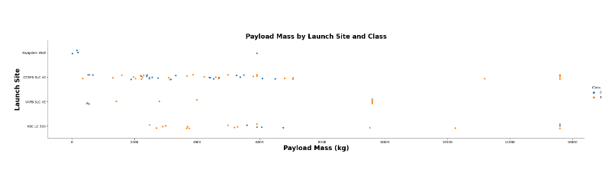
Data visualization
Data Visualization Using Python
Launch Site vs. Payload Mass
Light Payloads (under 5,000 kg): Most launches are successful across all sites, with few failures, particularly at VAFB SLC 4E.
Intermediate Payloads (5,000 kg to 10,000 kg): Success and failure rates are more balanced, especially at CCSFS SLC 40 and KSC LC 39A.
Heavy Payloads (above 10,000 kg): Most missions are successful, particularly from CCSFS SLC 40, which excels in launching heavy payloads with a high success rate.
Data Analysis
Data Cleaning

Slide 29
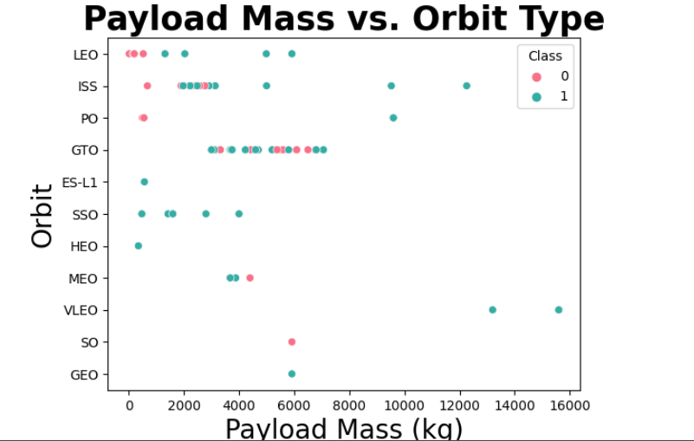
Data visualization
Data Visualization Using Python
OrbitType vs. Payload Mass
Early Mission Challenges: Early Falcon 9 missions had many failures in lower flight numbers, but success rates improved as flight numbers increased. Despite this overall improvement, orbits like 'GEO', 'SO', and 'ES-L1' experienced higher failure rates due to their greater complexities.
Data Analysis
Data Cleaning

Slide 30
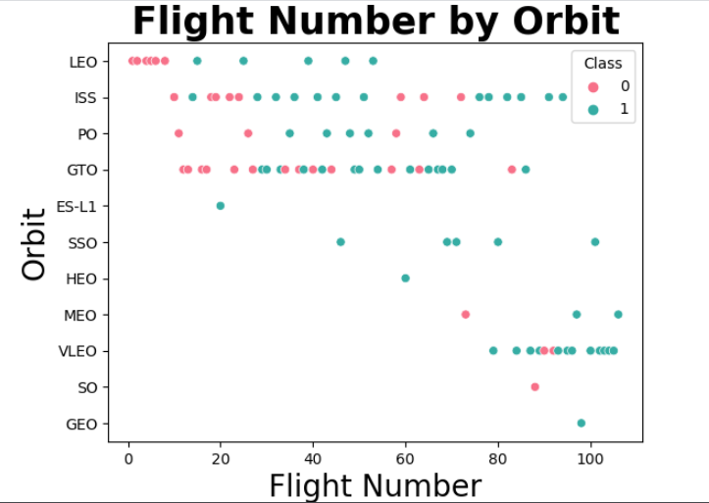
Data visualization
Data Visualization Using Python
OrbitType vs. Flight Number
Early Mission Difficulties: The initial Falcon 9 flights showed a higher failure rate (orange dots) across several orbit types, indicating early challenges. However, as flight numbers increased, success rates improved. Overall, most orbit types have shown progress over time, though orbits like 'GEO', 'SO', and 'ES-L1' have higher failure rates, reflecting the unique challenges of these missions.
Data Analysis
Data Cleaning

Slide 31
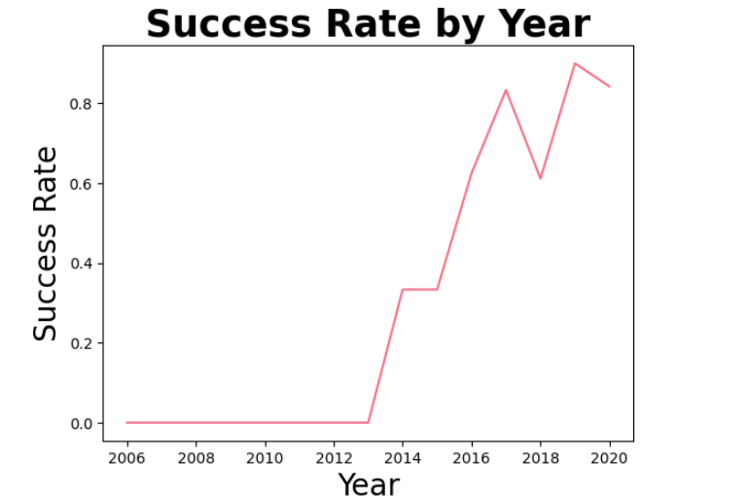
Data visualization
Data Visualization Using Python
Success rate per year
Since 2013 there has been a growing trend in landing success rates, with a possible plateau in the region of 0.9 after 2020.
The local minimum in 2018 requires a more detailed study to discover the root causes.
Data Analysis
Data Cleaning

Slide 32
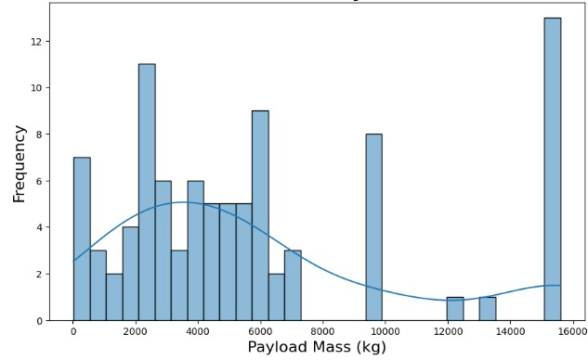
Data visualization
Data Visualization Using Python
Distribution of Payload Mass
The histogram the distribution of payload mass in kilograms (kg) against frequency. Key observations that can be made from the graph include:
Multimodal Distribution: The graph appears to have multiple peaks, suggesting the data may be divided into different clusters or categories of payload masses.
Higher Frequencies for Lower Masses: Most payloads fall in the lower mass range (0-5000 kg), which can be seen from the concentration of bars in this range.
Gaps in Data: There are some significant gaps, especially between 10,000 kg and 12,000 kg, indicating there are few payloads in that range.
Skewness: The tail of the distribution extends towards the higher payload mass (right), meaning the data is slightly right-skewed, with some extremely heavy payloads (around 16,000 kg).
In summary, the distribution shows that most payloads are lighter, but there are a few very heavy ones, possibly indicating different types of payloads or missions.
Data Analysis
Data Cleaning

Slide 33
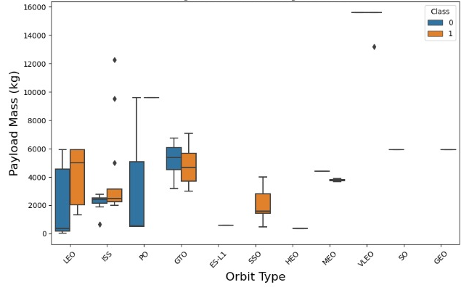
Data visualization
Data Visualization Using Python
Payload Mass by Orbit
The boxplot compares payload mass across different orbit types (e.g., LEO, GTO, etc.), with data separated by class 0 and class 1.
Key takeaways:
LEO (Low Earth Orbit) has the widest range of payload masses, with both successful (class and unsuccessful (class 0) flights showing significant variation.
GTO (Geostationary Transfer Orbit) has relatively heavier payloads, but there’s less variation compared to LEO.
Some orbit types (like ES-L1 and SO) show smaller or consistent payload masses.
In most orbit types, class 0 (unsuccessful) and class 1 (successful) flights have overlapping payload ranges, meaning payload mass does not have a clear influence on flight success across these orbits.
Overall, the chart suggests that different orbit types have varying payload mass ranges, and there isn't a strong correlation between payload mass and the likelihood of flight success.
Data Analysis
Data Cleaning

Slide 34
Data visualization
Data Visualization Using Python
Payload Mass by Orbit
The boxplot compares payload mass across different orbit types (e.g., LEO, GTO, etc.), with data separated by class 0 and class 1.
Key takeaways:
LEO (Low Earth Orbit) has the widest range of payload masses, with both successful (class and unsuccessful (class 0) flights showing significant variation.
GTO (Geostationary Transfer Orbit) has relatively heavier payloads, but there’s less variation compared to LEO.
Some orbit types (like ES-L1 and SO) show smaller or consistent payload masses.
In most orbit types, class 0 (unsuccessful) and class 1 (successful) flights have overlapping payload ranges, meaning payload mass does not have a clear influence on flight success across these orbits.
Overall, the chart suggests that different orbit types have varying payload mass ranges, and there isn't a strong correlation between payload mass and the likelihood of flight success.
Data Analysis
Data Cleaning

Slide 35
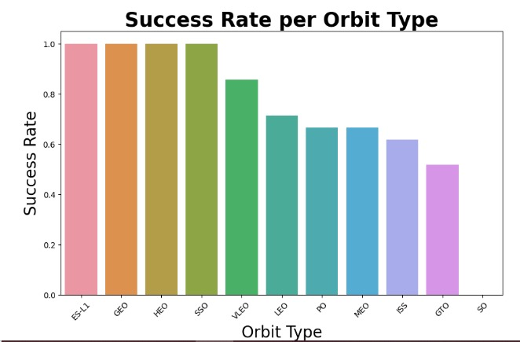
Data visualization
Data Visualization Using Python
Success Rate per Orbit Type
The orbits 'ES-L1', 'GEO', and 'HEO' demonstrate very high success rates, approaching 100%. However, as we shift towards 'SO', the success rate declines, with 'SO' showing the lowest success rate among the orbits presented.
Data Analysis
Data Cleaning

Slide 36
Data visualization
Data Visualization Using Python
Data Visualization Using Power BI

Slide 37
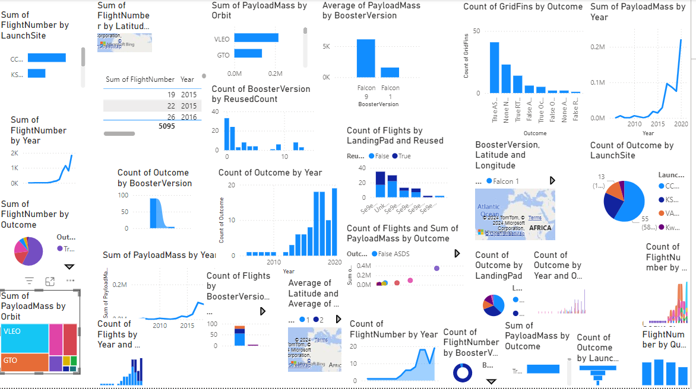
Data visualization
Data Visualization Using Power BI
Data Visualization Using Python

Slide 38
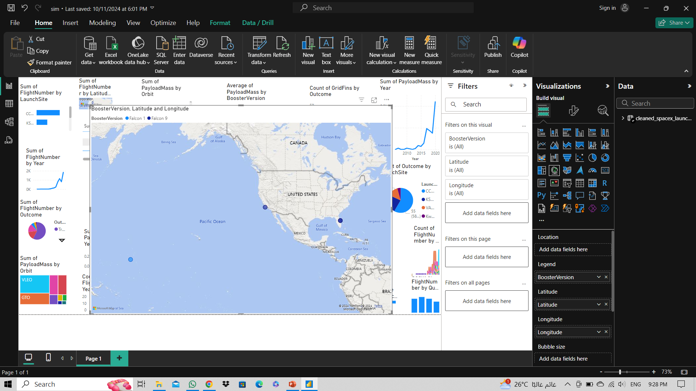
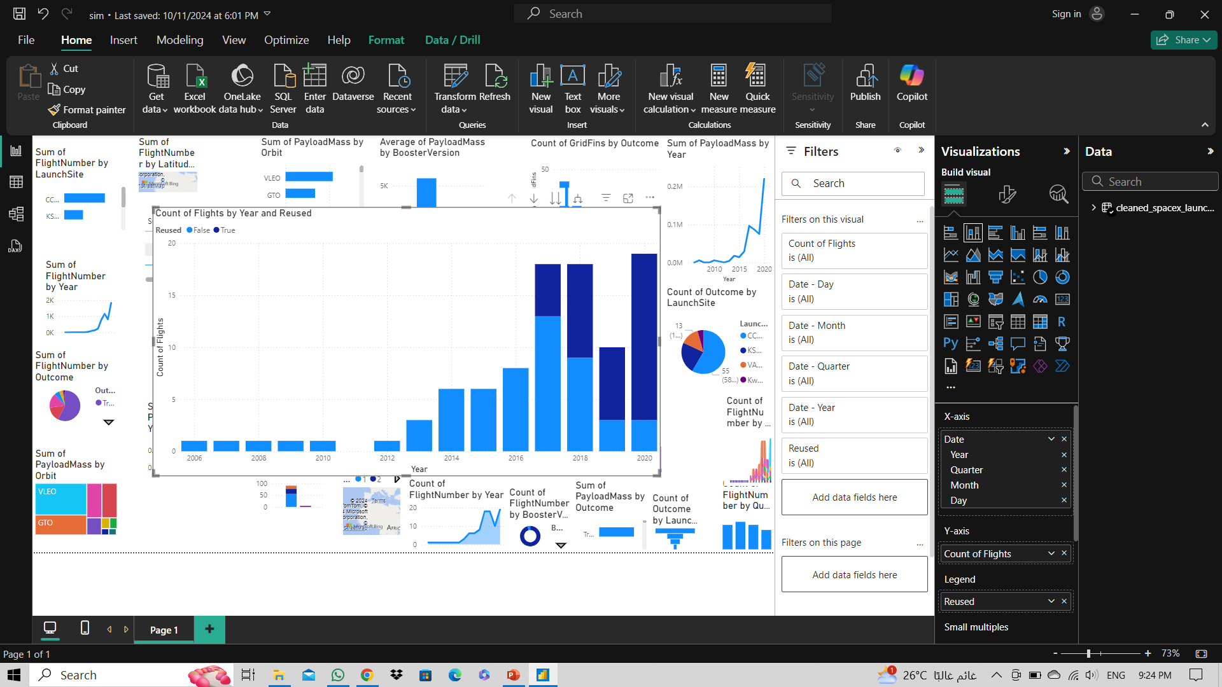
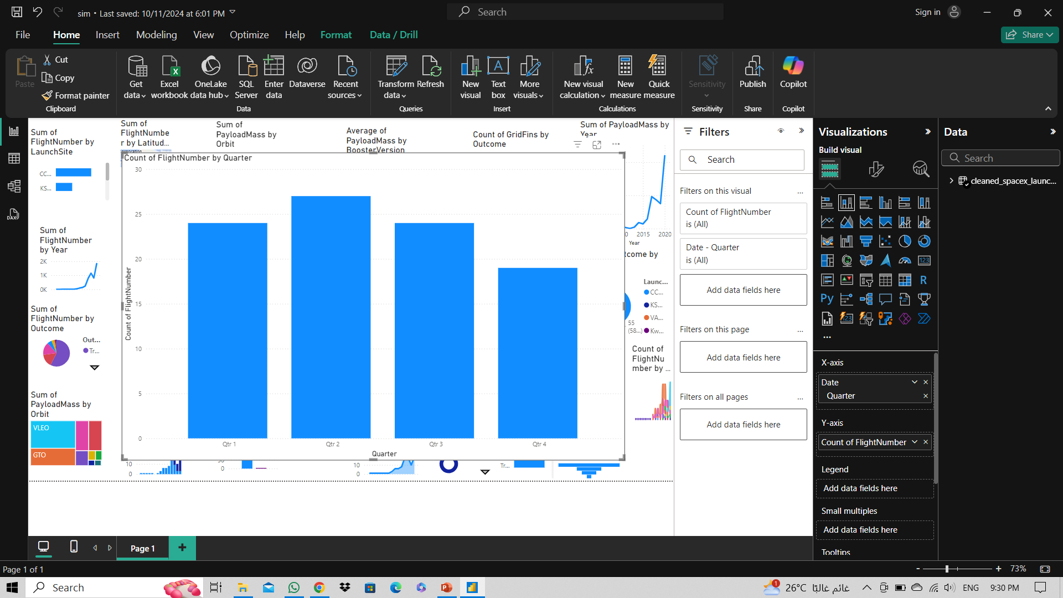
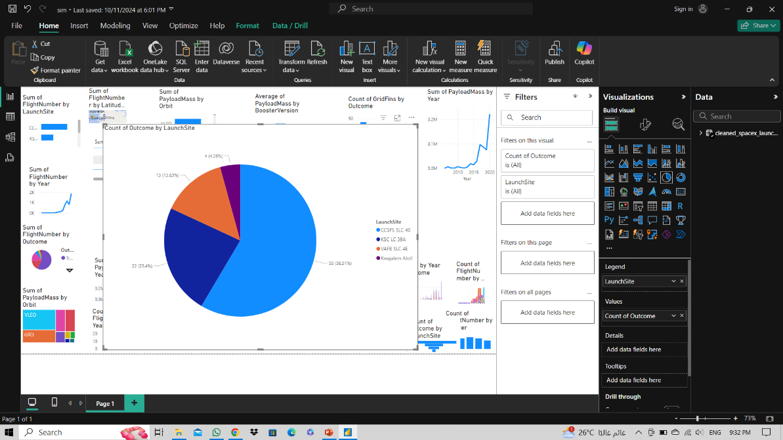
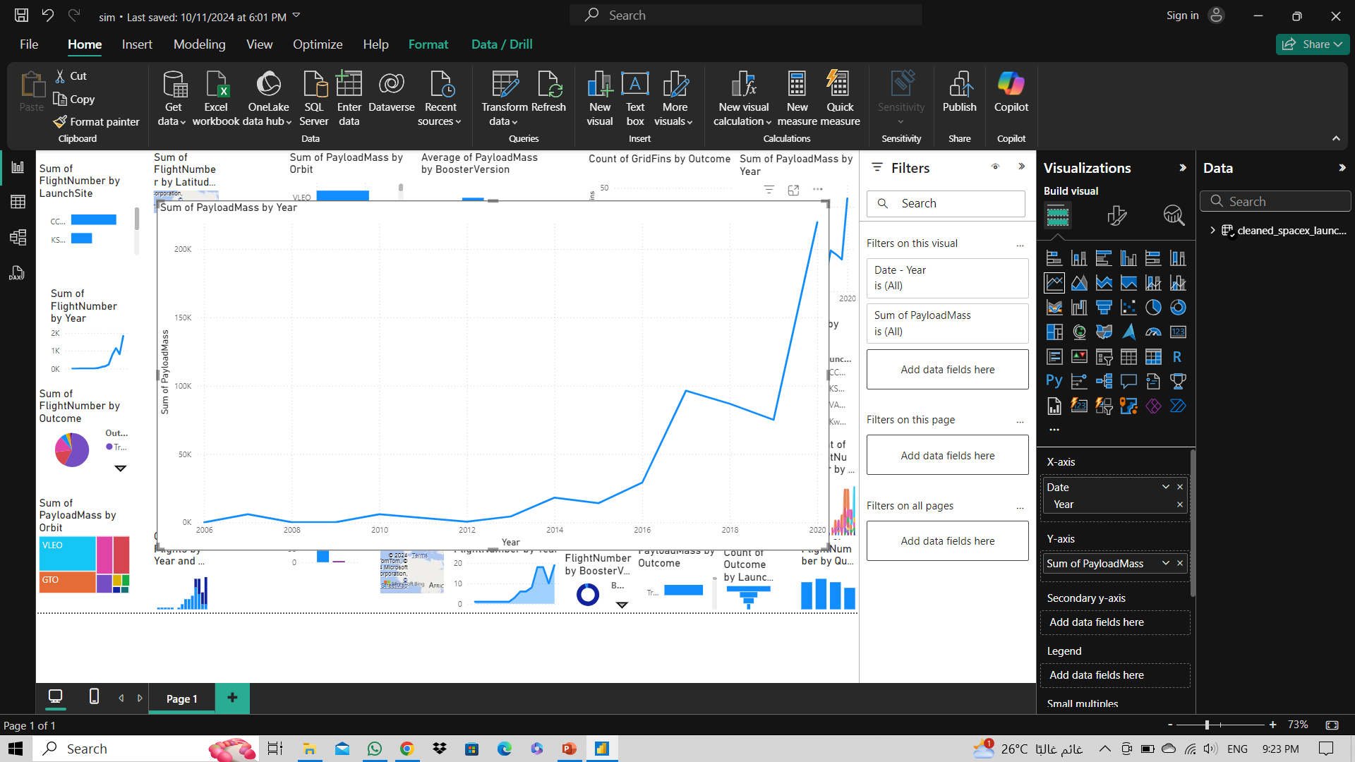
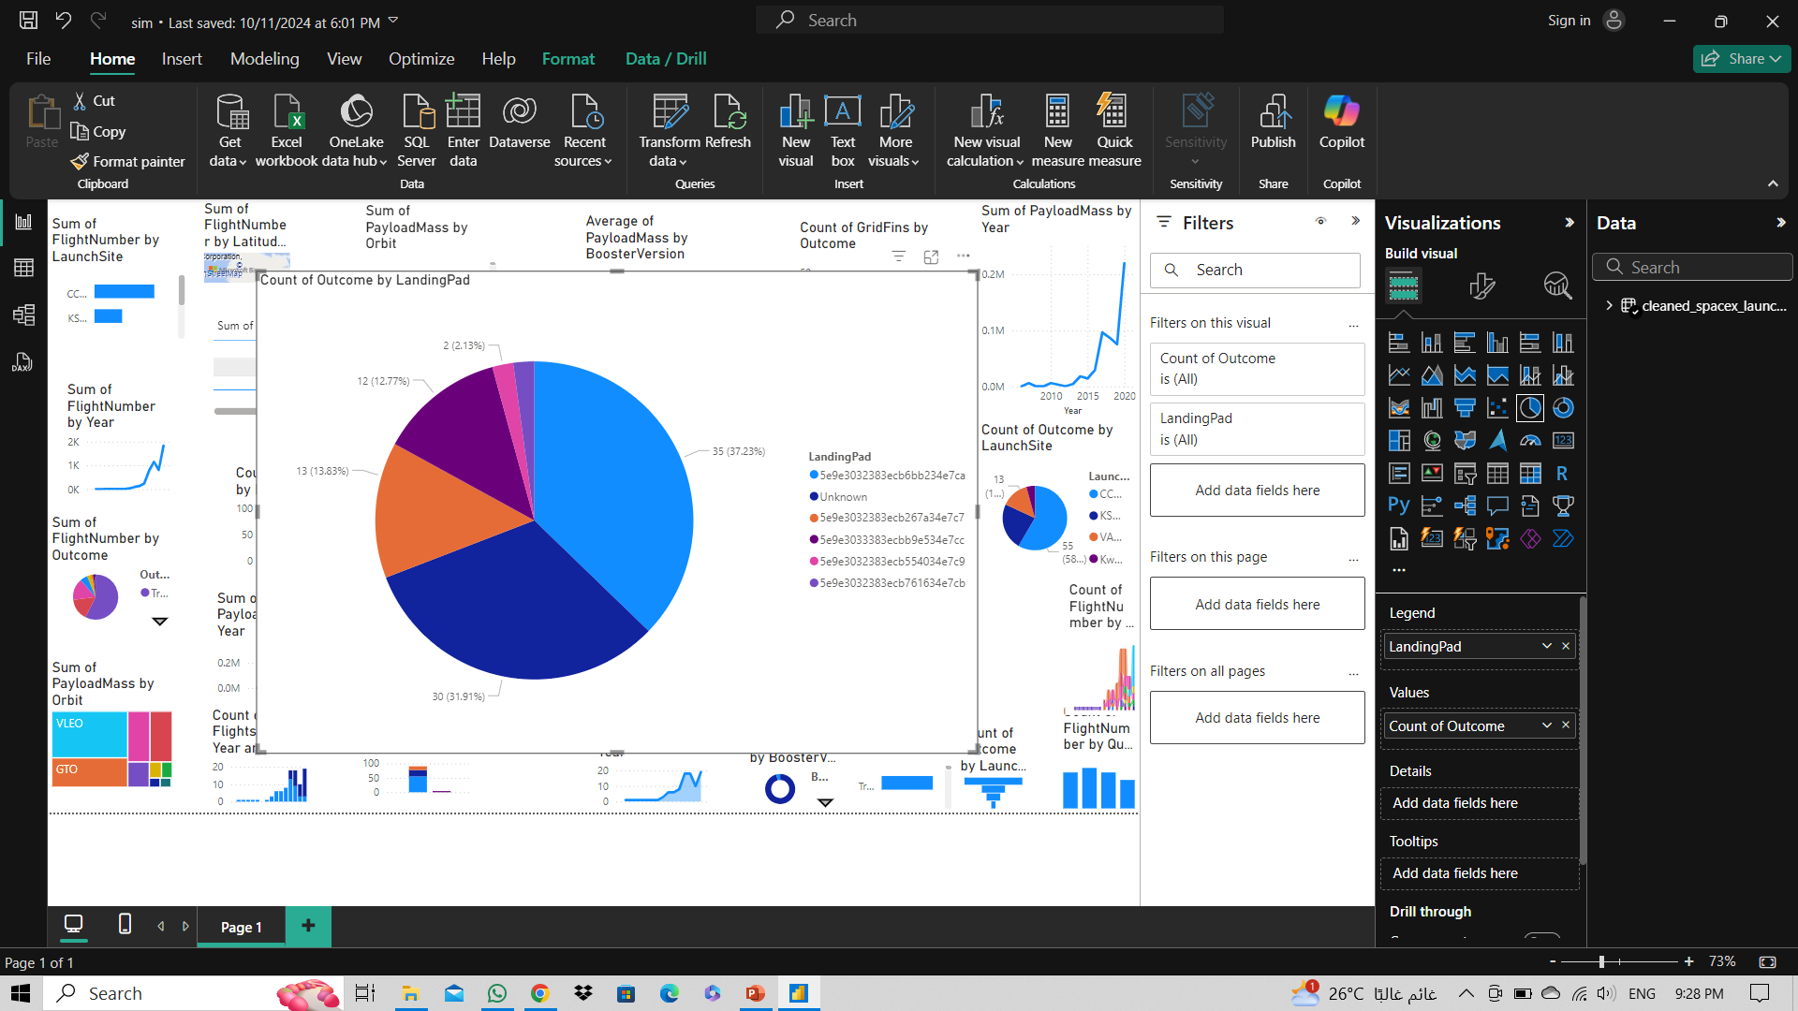
Data visualization
Data Visualization Using Power BI
Data Visualization Using Python

Slide 39
Data visualization
Data Visualization Using Power BI
Data Visualization Using Python

Slide 40
Data visualization
Data Visualization Using Power BI
Data Visualization Using Python

Slide 41
Data visualization
Data Visualization Using Power BI
Data Visualization Using Python

Slide 42
Data visualization
Data Visualization Using Power BI
Data Visualization Using Python

Slide 43

Data visualization
Data Visualization Using Power BI
Data Visualization Using Python

Slide 44
Data visualization
Data Visualization Using Power BI
Data Visualization Using Python

Slide 45
Machine Learning Model Development
Model Selection
Model Training

Slide 46
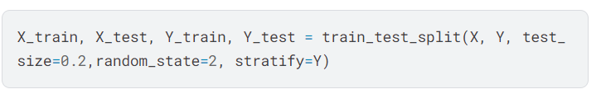
Machine Learning Model Development
Model Selection
Training and Testing Split:
Title: Model Selection with GridSearchCV
Content:
Objective: To find the best classifier for the prediction task.
Models Tested:
Decision Tree
K-Nearest Neighbors (KNN)
Logistic Regression
Support Vector Machine (SVM)
Hyperparameter Tuning: GridSearchCV used to optimize model parameters through cross-validation (Stratified K-Fold).
Model Training

Slide 47
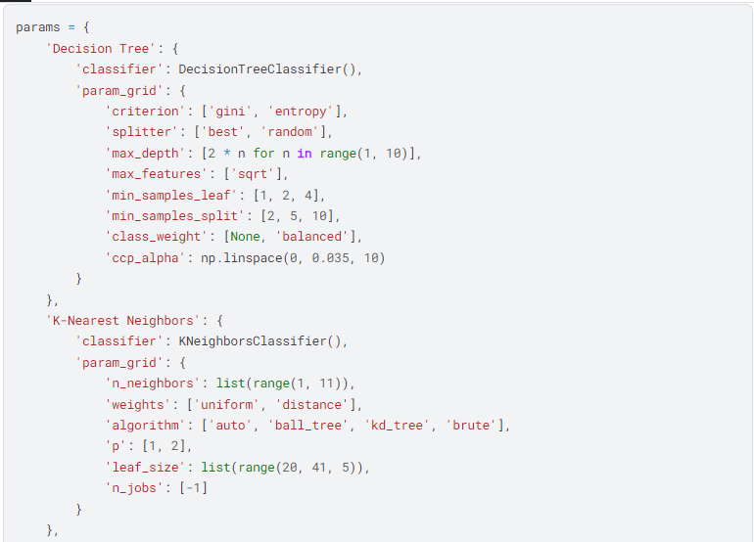
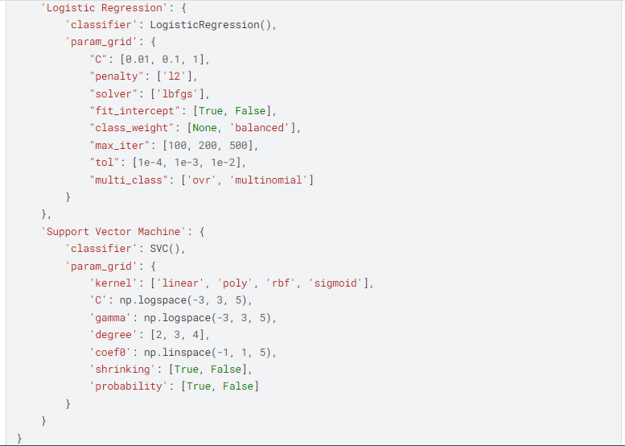
Machine Learning Model Development
Model Selection
Hyperparameters for different models
Model Training

Slide 48
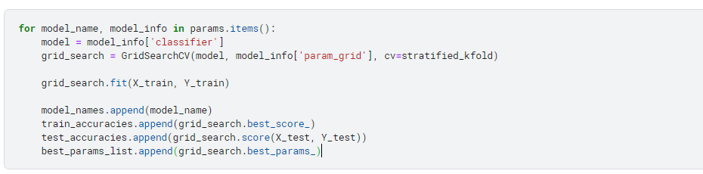
Machine Learning Model Development
Model Selection
Iterate over each model to perform hyperparameter tuning
Model Training

Slide 49
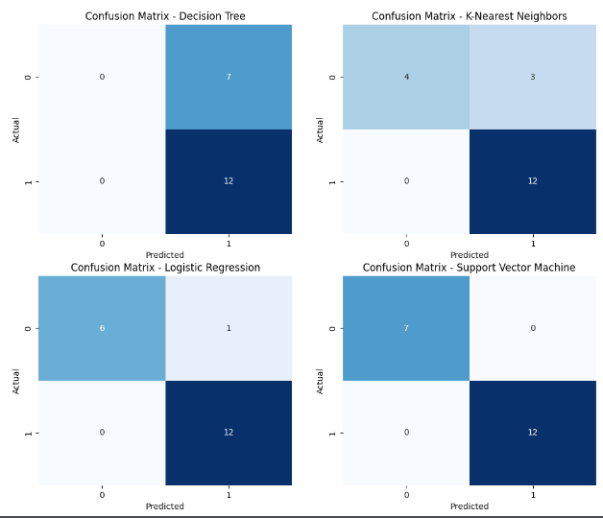
Machine Learning Model Development
Model Selection
Confusion matrices
Model Training

Slide 50
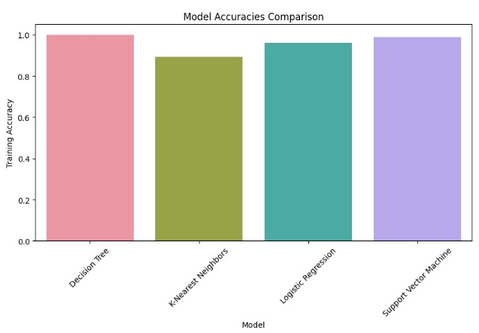
Machine Learning Model Development
Model Selection
Comparison of the accuracy of the four algorithms
Model Training

Slide 51
Machine Learning Model Development
Model Selection
Model Training

Slide 52
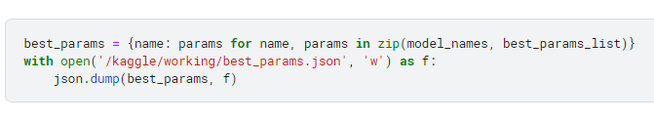
Machine Learning Model Development
Model Selection
Save best hyperparameters to a JSON file
Model Training

Slide 53
Machine Learning Model Development
Model Selection
Model Training

Slide 54
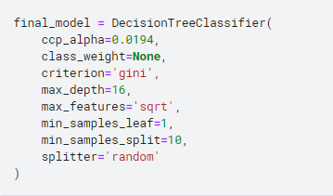
Machine Learning Model Development
Model Training
Training the Decision Tree Classifier Model:
Model Selection

Slide 55
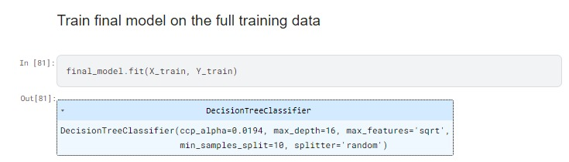
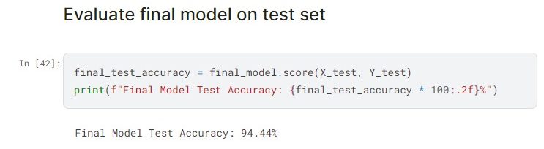
Machine Learning Model Development
Model Training
Model Selection

Slide 56
Mlops, deployment, and final presentation
MLflow Integration
Deployment
Conclusion

Slide 57
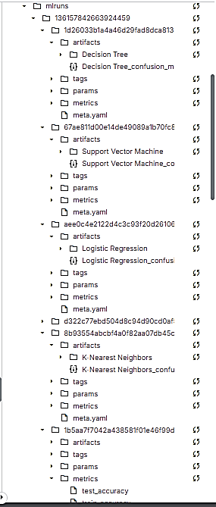
Mlops, deployment, and final presentation
Experiment Tracking with MLflow
Overview:
Objective: Compare multiple machine learning models for predicting the success of Space Y missions using GridSearchCV and MLflow for experiment tracking.
Data:
Features: 'PayloadMass', 'Orbit', 'LaunchSite'
Target: 'Class' (Success or Failure)
ML Models Used:
Decision Tree Classifier
K-Nearest Neighbors Classifier
Logistic Regression
Support Vector Machine (SVM)
Deployment
Conclusion

Slide 58
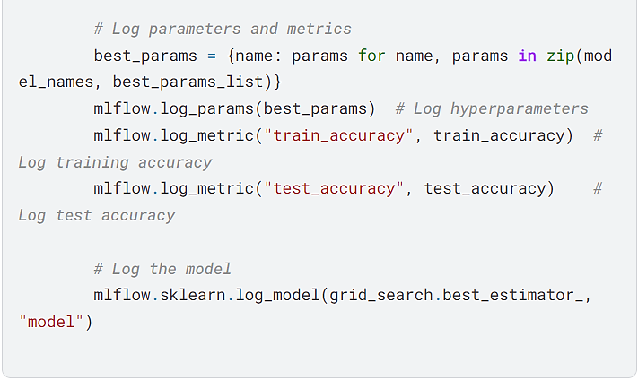
Mlops, deployment, and final presentation
Experiment Tracking with MLflow
Slide 2: Model Comparison and Results
Experiment Tracking Process:
MLflow: Logs hyperparameters, accuracy, and best models.
Hyperparameter Tuning: Using GridSearchCV with StratifiedKFold.
Deployment
Conclusion

Slide 59
Mlops, deployment, and final presentation
MLflow Integration
Deployment
Conclusion

Slide 60
Mlops, deployment, and final presentation
Deployment
Objective:
Predict the success or failure of Space Y missions using machine learning models based on features:
Mass Payload
Orbit
Launch Site
Conclusion
MLflow Integration

Slide 61
Mlops, deployment, and final presentation
Deployment
Model Pipeline and Prediction Interface
Pipeline Overview:
1- Data Preprocessing:
Scaling: Normalize PayloadMass using StandardScaler.
One-Hot Encoding: Transform categorical features like Orbit and Launch Site.
2- Model:
3- Web Interface:
Gradio is used to build an interface where users can input mission details to receive predictions in real-time.
Conclusion
MLflow Integration

Slide 62
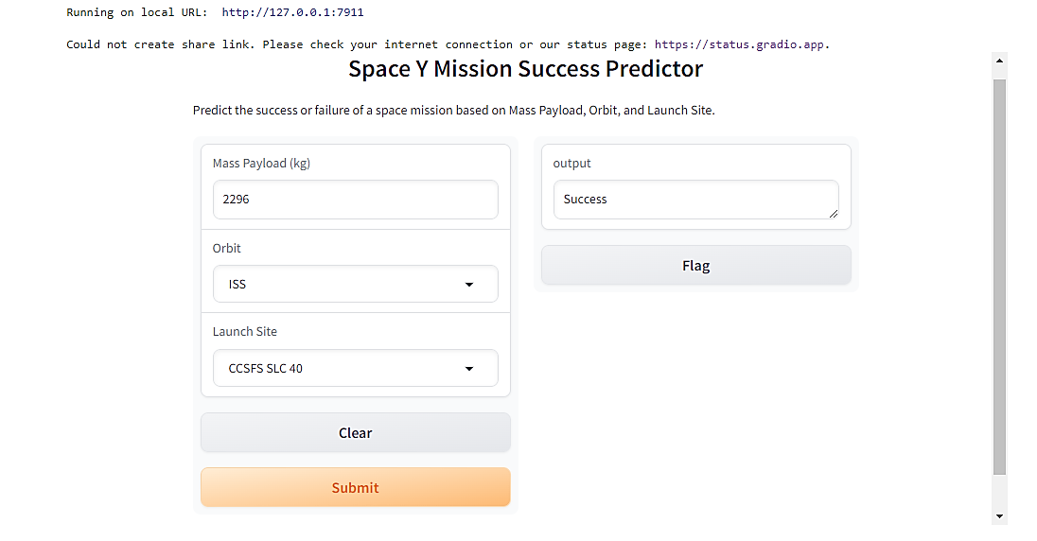
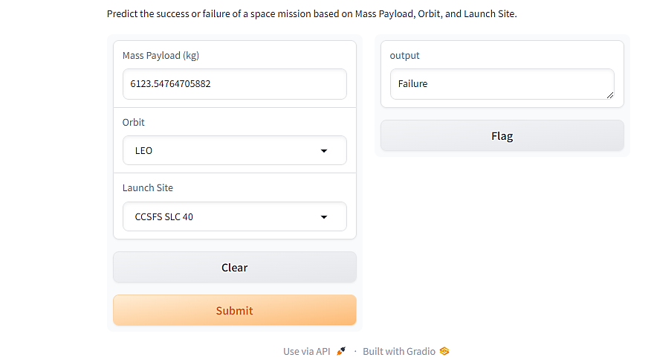
Mlops, deployment, and final presentation
Deployment
Gradio Interface:
Simple web interface where users provide:
Mass Payload (kg)
Orbit (LEO, GTO, ISS, etc.)
Launch Site (KSC LC 39A, etc.)
Predicts "Success" or "Failure" based on the input
Conclusion
MLflow Integration

Slide 63
Mlops, deployment, and final presentation
Deployment
Conclusion
MLflow Integration

Slide 64
Mlops, deployment, and final presentation
MLflow Integration
Deployment
Conclusion

Slide 65
Mlops, deployment, and final presentation
Conclusion
Summary of the project outcomes:
Successfully built a model to predict SpaceY landing success.
Optimized with GridSearchCV and tracked with MLflow.
Deployed using Gradio for public interaction.
Future Improvements:
More advanced models .
Collect more recent data to improve prediction accuracy.
Deployment
MLflow Integration

Slide 66

Thank you
Deployment
MLflow Integration

